Slide 1
Problem statement: Predict if client will subscribe to direct marketing campaign for a banking institution

Slide 2
Steps to be followed to solve the problem.
Exploratory Data Analysis
Feature Engineering
Feature Selection
Model creation

Slide 3
EDA performed on bank_additional_full Dataset
Reason of selection:
Additional features
Current trend of Customers

Slide 4
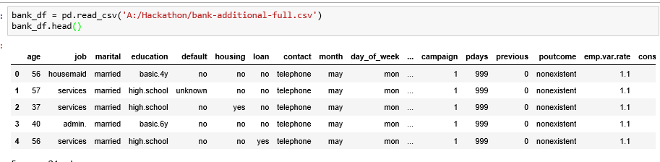
Overview of Dataset

Slide 5
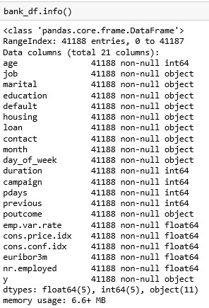
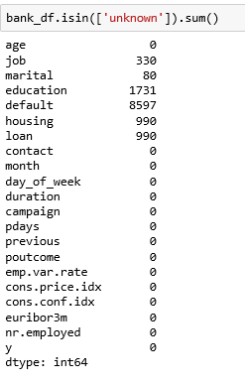

Slide 6
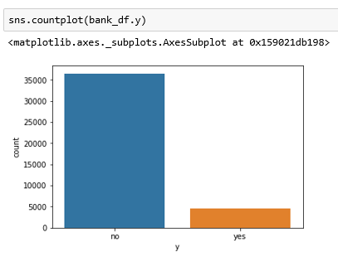

Exploratory Data Analysis

Slide 7
By looking at previous plot, we need to perform undersampling or oversampling

Slide 8
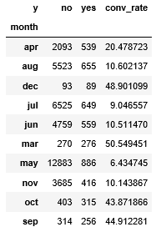
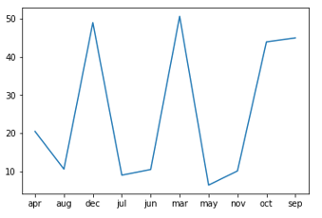
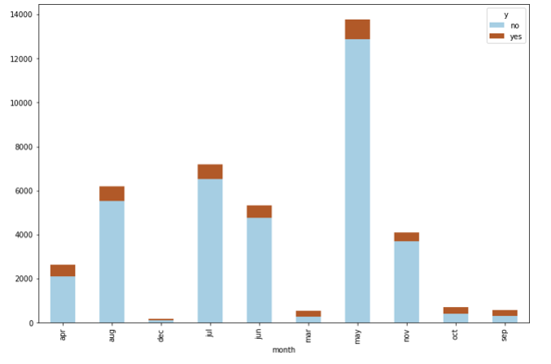
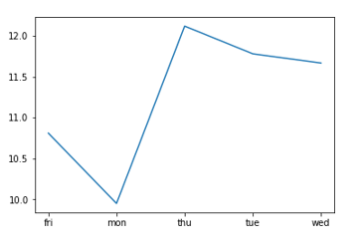
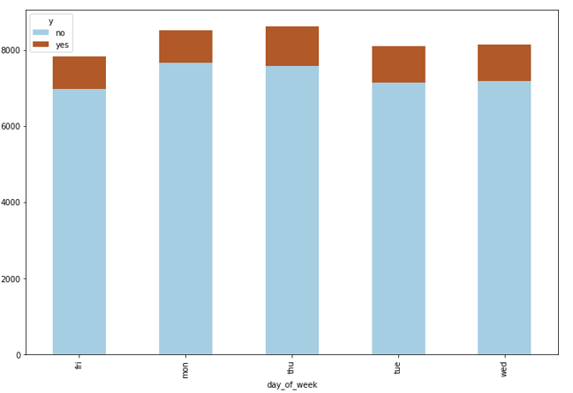
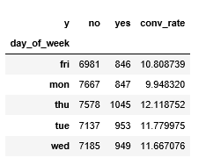
Month vs ‘Y’ and day of week vs ‘Y’

Slide 9
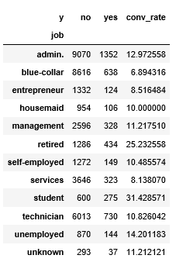
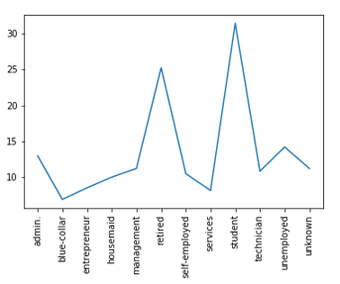
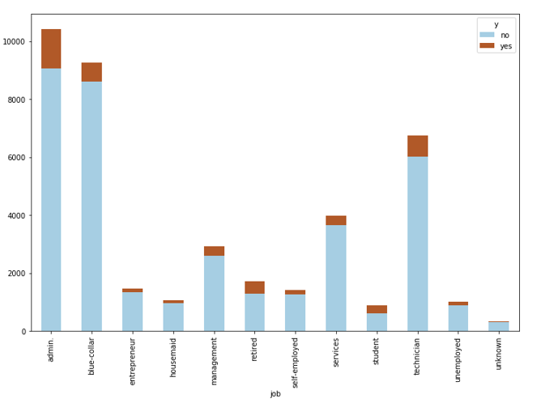
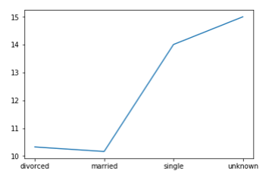
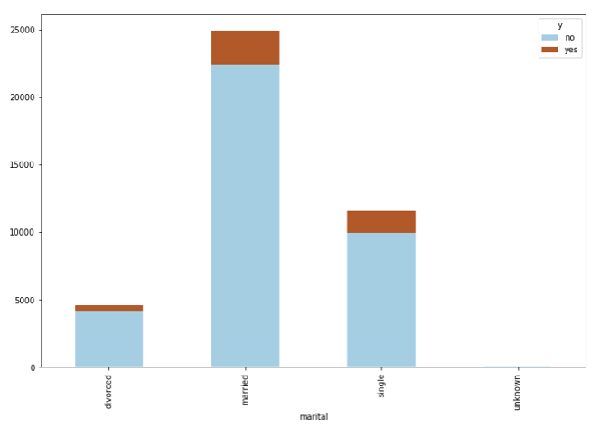
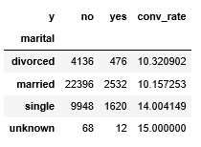
Job vs ‘Y’ and Marital vs ‘Y’

Slide 10
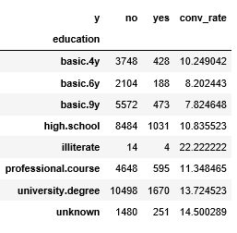
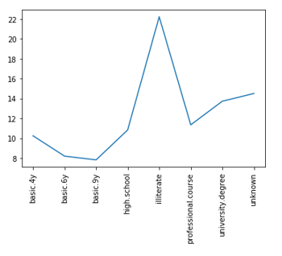
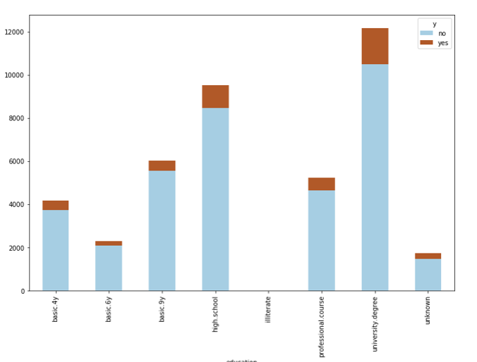
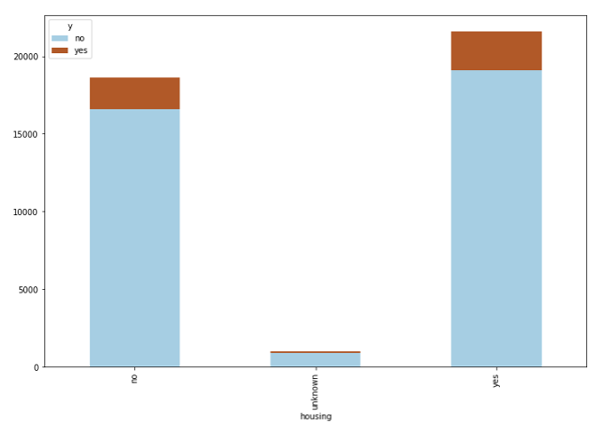
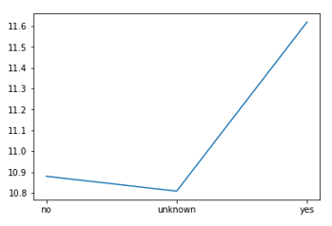
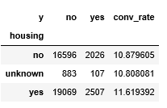
Education vs ‘Y’ and Housing vs ‘Y’

Slide 11
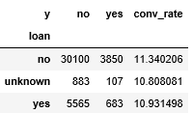
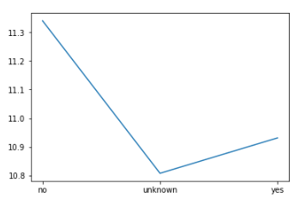
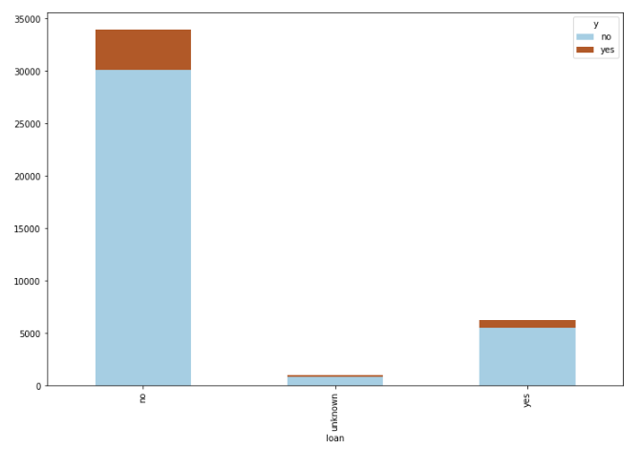
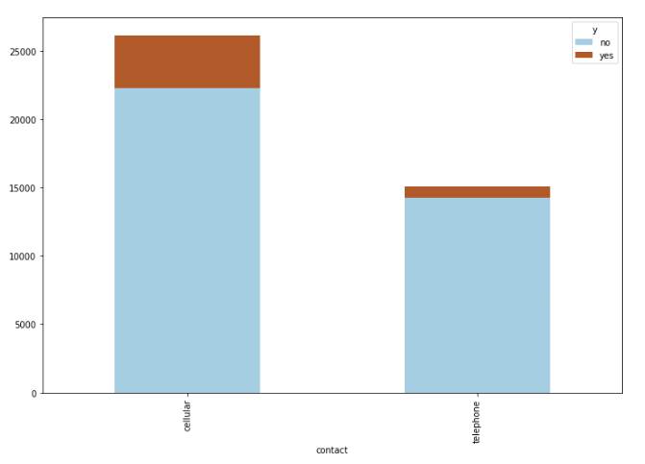
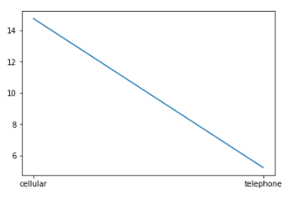
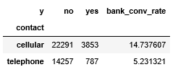
Loan vs ‘Y’ and Contact vs ‘Y’

Slide 12
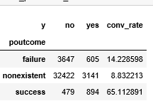
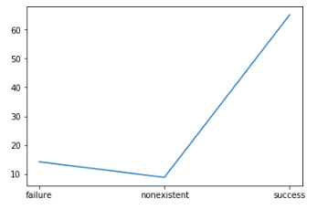
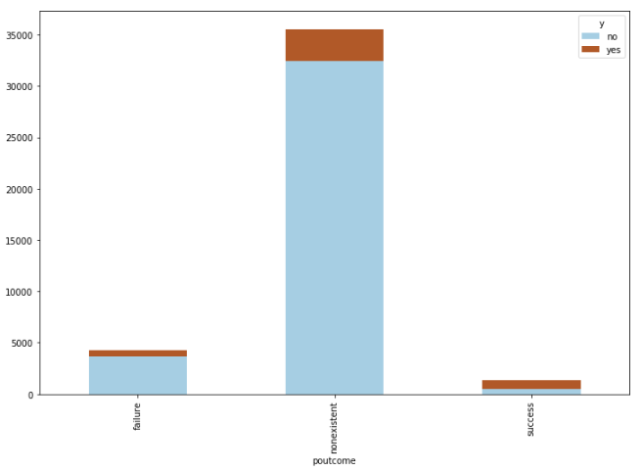
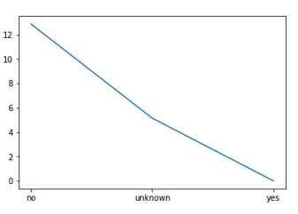
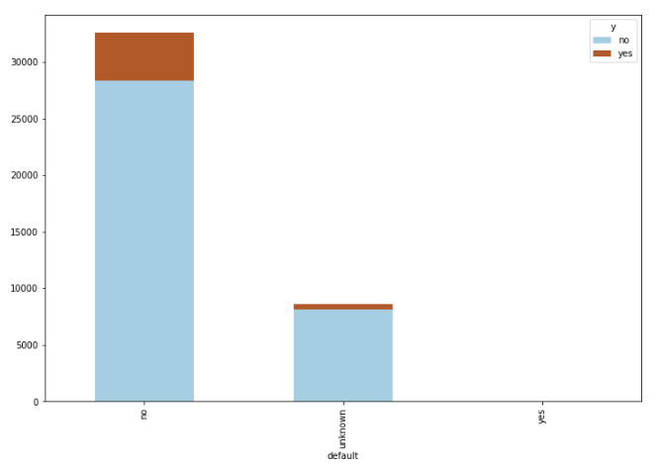
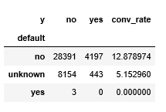
Pout come vs ‘Y’ and default vs ‘Y’

Slide 13
Observation from above Plots
1.Conversion rate is high in March, Oct,Sep and December
2. Retired and students are most likely to subscribe to term deposit.
3. Divorced and single are the maximum, so are most likely to subscribe to term deposit
4. People with No personal loan are most likely to subscribe
5. People with cell phones are most likely to subscribe
6. Clearly shows that previously defaulted customers are not preferred

Slide 14
Feature Engineering
1.Marital
2.Job
3.Education

Slide 15
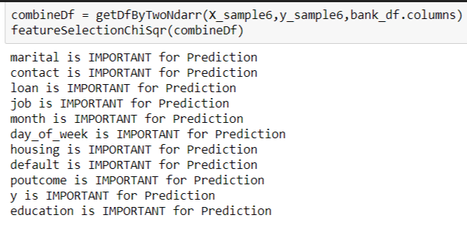
Feature Selection
Chi-square
LDA

Slide 16
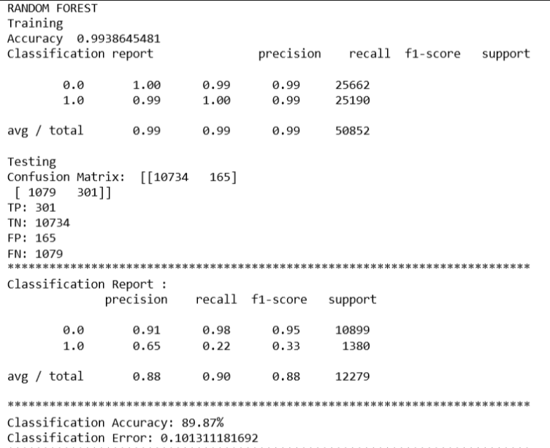
Models Used
Random Forest
oversampling

Slide 17
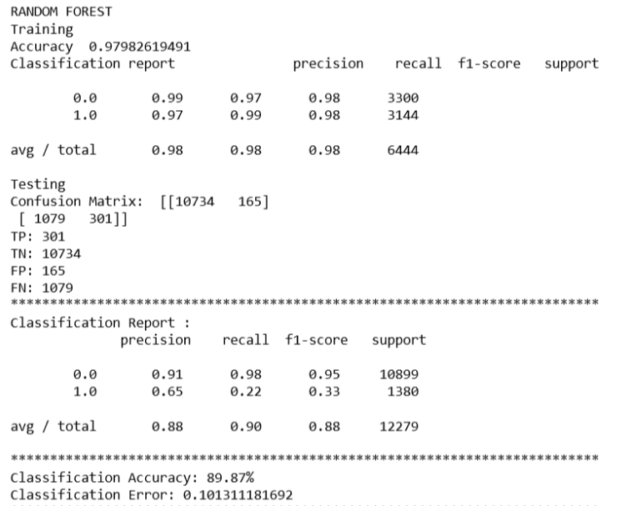
Random Forest
undersampling

Slide 18
Thanks!

